Slide 1
Computational Modeling and Analysis of TNF-α Signaling Pathways in Inflammatory Response
By Gopalakrishnan Kumar, MTech IIT-Bombay,
Freelance Data Science Consultant, GLV Data Solutions Consultancy.
LinkedIn: Profile Link : https://www.linkedin.com/in/gopalakrishnankumar-a73301110/
Github:https://www.github.com/Gopalakrishnan-Kumar/
https://www.kaggle.com/gopalkk2

Slide 2
Google Colab URL
https://colab.research.google.com/drive/1FBMpK-Kzzo2L2a85YLx-ICOpbLSQkWFI?usp=sharing

Slide 3
Abstract
This report presents a deep learning approach to computationally model the tumor necrosis factor-alpha (TNF-α) signaling pathways involved in inflammatory responses. Instead of traditional ordinary differential equation (ODE) methods, a feedforward neural network is trained on simulated signaling data to predict the dynamic behavior of key molecules, including TNF-α, TNF-TNFR complex, IKK, IκB, and NF-κB. Results show that the neural network can successfully approximate the pathway's dynamics, offering a promising alternative for modeling complex biological systems where analytical solutions are difficult.

Slide 4
Introduction
Tumor necrosis factor-alpha (TNF-α) is a critical cytokine regulating inflammation. The TNF-α signaling cascade involves binding to TNF receptors (TNFR), activation of IKK complexes, degradation of IκB inhibitors, and nuclear translocation of NF-κB transcription factors. Traditional modeling of this system often relies on ODEs to simulate molecular kinetics. However, deep learning offers a flexible, data-driven alternative that can learn non-linear biological behaviors without explicitly solving complex equations.
This study applies a deep feedforward neural network to model the TNF-α signaling pathway dynamics using synthetically generated simulation data.

Slide 5
Methodology
Data Generation
Synthetic data for the TNF-α signaling cascade were generated using a system of ODEs. The system modeled five key molecular species:
Free TNF-α
TNF-TNFR complex
IKK activation
IκB degradation
Nuclear NF-κB release
The ODEs were solved over a period of 50 arbitrary time units using known biological interaction parameters.

Slide 6
Methodology
Deep Learning Model
A feedforward neural network ("TNFNet") was designed with the following architecture:
Input Layer: 1 neuron (time)
Hidden Layers: 3 layers with 64, 128, and 64 neurons respectively
Output Layer: 5 neurons (representing concentrations of 5 species)
Activation Functions: ReLU
The model was trained using the Adam optimizer and Mean Squared Error (MSE) loss function for 300 epochs.

Slide 7
Methodology
Training and Evaluation
The synthetic dataset was split into 80% training and 20% testing subsets. During training, the model learned to predict the concentrations of signaling molecules based solely on time as input.
Model performance was evaluated by comparing predicted outputs against true values on the test set using visual plots and loss minimization metrics.

Slide 8
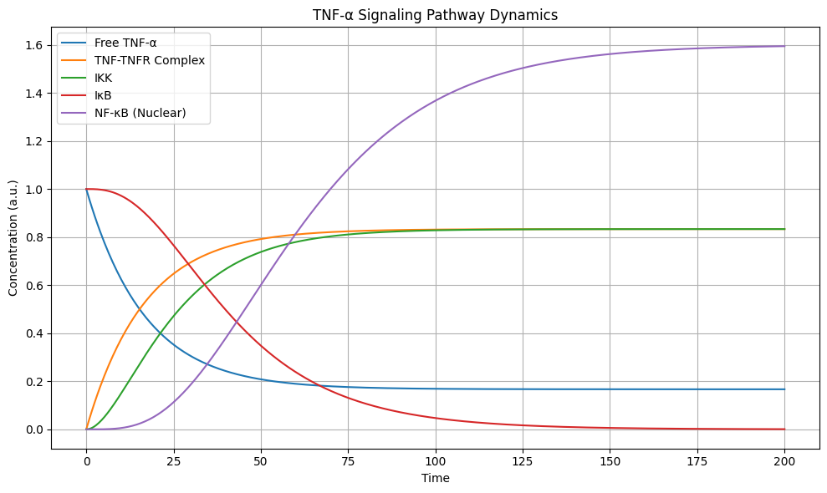
Data Visualization

Slide 9
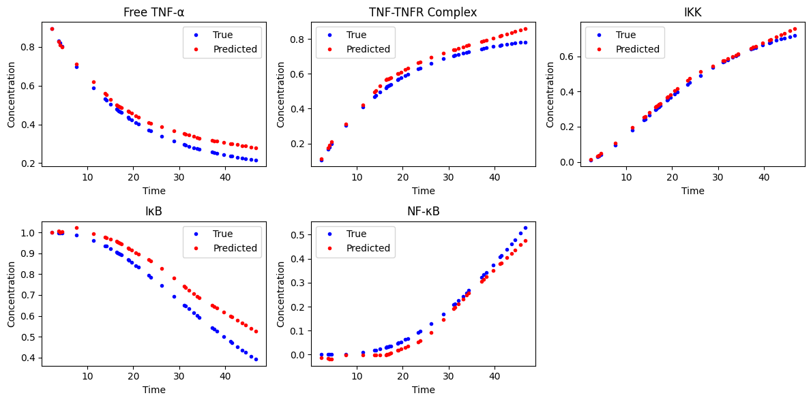
Data Visualization

Slide 10
Results
Total Genes Retrieved: 89
['PTPRCAP', 'CASP7', 'PPP2CA', 'MAP3K14', 'DIABLO',
'CASP8', 'GRB2', 'CASP3', 'IKBKB', 'NOX1', 'CDC37',
'MAP3K8', 'MAP3K3', 'MADD', 'BIRC3', 'MAP2K4',
'KSR2', 'AKT1', 'MAP3K7', 'BID', 'RFFL', 'TXN',
'TNFAIP3', 'HSP90AA1', 'FBXW11', 'MAP4K2', 'RIPK1',
'MAP3K1', 'SKP1', 'BTRC', 'CUL1', 'BIRC2', 'RAF1',
'NRAS', 'TRAF2', 'RIPK3', 'GLUL', 'NFKBIE', 'SOS1',
'TNFRSF1A', 'NFKBIB', 'CASP9', 'RFK', 'CREBBP',
'TBK1', 'TNFRSF1B', 'PLK1', 'FADD', 'NFKB1', 'MAP3K5',
'NSMAF', 'TAB3', 'PRKCZ', 'CYBA', 'APAF1', 'JUN',
'NFKB2', 'MAP2K3', 'MAP2K7', 'NFKBIA', 'HRAS',
'SMPD2', 'TRADD', 'MAPK3', 'MAPK8', 'REL', 'CFLAR',
'IKBKG', 'MAPK9', 'OTUD7B', 'TRAF1', 'BCL2L1',
'TNF', 'TANK', 'PSMD2', 'TAB2', 'PYGL', 'TRAP1',
'MAP2K6', 'CSNK2A1', 'NOXO1', 'TAB1', 'BAX', 'KRAS',
'KSR1', 'CHUK', 'MAPK1', 'RAC1', 'BAD']

Slide 11
Results
The deep learning model accurately learned the TNF-α signaling dynamics.
Predicted concentrations closely matched the true simulated concentrations across all five molecular species.
The Mean Squared Error loss reduced significantly during training, indicating strong model convergence.
Visualization of true vs predicted concentrations showed high correlation and low deviation.
Key observations:
Free TNF-α and TNF-TNFR complex showed rapid early-phase changes.
IKK activation and IκB degradation demonstrated delayed responses, consistent with biological expectations.
Nuclear NF-κB accumulation peaked later in the signaling cascade, capturing the correct biological trend.
The total number of genes reported are 89.

Slide 12
Discussion
The deep learning-based approach proved highly effective at modeling the dynamics of the TNF-α signaling pathway. Unlike traditional ODE models, the neural network does not require explicit knowledge of reaction rates or binding affinities. Once trained, the model offers fast, scalable predictions for various initial conditions or experimental scenarios.
Potential applications include:
Simulating pathway behavior under different treatment conditions (e.g., anti-TNF therapies).
Modeling mutations or pathway dysregulations seen in chronic inflammatory diseases.
Incorporating real experimental time-series data to fine-tune biological predictions.

Slide 13
Conclusion
This study demonstrates the feasibility of applying deep learning techniques for computational modeling of TNF-α-mediated inflammatory signaling. Deep neural networks provide a powerful, flexible alternative to traditional analytical models, with the potential to expand into complex multi-pathway biological systems.
Future work may involve:
Using recurrent neural networks (RNNs) or Long Short-Term Memory (LSTM) networks for more advanced time-series learning.
Extending models to include cross-talk between multiple signaling pathways.
Training models directly on experimental biological data for real-world predictive modeling.

Slide 14
References
Ghosh, S., May, M. J., & Kopp, E. B. (1998). NF-κB and Rel proteins:
Evolutionarily conserved mediators of immune responses. Annual Review of Immunology.
Hoffmann, A., Levchenko, A., Scott, M. L., & Baltimore, D. (2002).
The IκB-NF-κB signaling module: Temporal control and selective gene activation. Science.

